Slide 2
Direct Patient Care
Proposal for Implementation with Integrated provider Networks

Slide 3
What is Direct Primary Care?
Direct Primary Care (DPC) is an innovative alternative payment model improving access to high functioning healthcare with a simple, flat, affordable membership fee. No fee-for-service payments. No third party billing. The defining element of DPC is an enduring and trusting relationship between a patient and his or her primary care provider. Patients have extraordinary access to a physician of their choice, often for as little as $70 per month, and physicians are accountable first and foremost their patients. DPC is embraced by health policymakers on the left and right and creates happy patients and happy doctors all over the country!

Slide 4
Direct Patient Care Definition
Direct primary care agreement” means a contract between a primary care provider and a patient, a patient’s legal representative, or a patient’s employer, which meets the requirements of subsection (4) and does not indemnify for services provided by a third party.

Slide 5
DPC-PCP
“Primary care provider” means a health care provider licensed under chapter 458, chapter 459, chapter 460, or chapter 464, or a primary care group practice, who provides primary care services to patients.
“Primary care services” means the
screening, assessment, diagnosis, and treatment of a patient
conducted within the competency and training of the primary care provider for the purpose of promoting health or detecting and managing disease or injury.

Slide 6
For purposes of this section, a direct primary care agreement must:
Be in writing.
Be signed by the primary care provider or an agent of the primary care provider and the patient, the patient’s legal representative, or the patient’s employer
Allow a party to terminate the agreement by giving the other party at least 30 days’ advance written notice. The agreement may provide for immediate termination due to a violation of the physician-patient relationship or a breach of the terms of the agreement.
Describe the scope of primary care services that are covered by the monthly fee.
Specify the monthly fee and any fees for primary care services not covered by the monthly fee
Specify the duration of the agreement and any automatic renewal provisions.
Offer a refund to the patient, the patient’s legal representative, or the patient’s employer of monthly fees paid in advance if the primary care provider ceases to offer primary care services for any reason.

Slide 7
Contain, in contrasting color and in at least 12-point type, the following statement on the signature page:
This agreement is not health insurance and the primary care provider will not file any claims against the patient’s health insurance policy or plan for reimbursement of any primary care services covered by the agreement. This agreement does not qualify as minimum essential coverage to satisfy the individual shared responsibility provision of the Patient Protection and Affordable Care Act, 26 U.S.C. s. 5000A. This agreement is not workers’ compensation insurance and does not replace an employer’s obligations under chapter 440.”

Slide 8
DPC
The direct primary care (DPC) model gives providers a meaningful alternative to fee-for-service insurance billing, typically by charging patients a monthly, quarterly, or annual fee (i.e., a retainer) that covers all or most primary care services including clinical, laboratory, and consultative services, and care coordination and comprehensive care management.
DPC practices often suggest that patients acquire a high-deductible wraparound policy to cover emergencies. Direct primary care and concierge care are not synonymous. In practices offering concierge care, the patient typically pays a high retainer fee in addition to insurance premiums and other plan obligations (e.g., copays, out-of-pocket expenditures), and the practice continues to bill the patient’s insurance carrier.

Slide 9
House Bill No. 37
An act relating to direct primary care agreements; creating s. 624.27, F.S.; providing definitions; specifying that a direct primary care agreement does not constitute insurance and is not subject to the Florida Insurance Code; specifying that entering into a direct primary care agreement does not constitute the business of insurance and is not subject to the code; providing that a certificate of authority is not required to market, sell, or offer to sell a direct primary care agreement; specifying requirements for a direct primary care agreement: Providing an effective date.

Slide 10
HR 6199 Restoring Access to Medication and Modernizing Health Savings Accounts Act of 2018
The House passed HR 6199 Restoring Access to Medication and Modernizing Health Savings Accounts Act of 2018, which included language from the Primary Care Enhancement Act sponsored by Rep. Eric Paulsen (R-MN) and Earl Blumenauer (D-OR), by a vote of 277-142. The language still contains a $150 per member per month ($300 for family plans) limitation to keep the pre-tax amount down.
CPT codes,however, were eliminated from its passage. This clears the way for millions of Americans with HSAs to have great access to affordable primary care from a DPC doctor of their choice. While not perfect this will allow almost all DPC practices to see patients with HSAs and allow their fees to be paid from the HSA.

Slide 11
DPC Wrap Around
Section 1301 (a) (3) of the Patient Protection and Affordable Care Act (ACA) states that a qualified direct primary care medical home plan plus a qualified health plan (wrap-around insurance) that together meet all other applicable requirements are eligible to participate in state and national health insurance exchanges. Qliance and the Direct Primary Care Coalition hired lobbyist Jay Keese of Capitol Associates in Washington, D.C., to get that provision into the ACA.

Slide 12
Insurance Carriers
most cost effective way to pay for healthcare is to pair DPC with a high-deductible wraparound policy.
For day-to-day healthcare, DPC is paid for in a model that is akin to a gym membership — a flat monthly fee regardless of how much one uses it(though some have co-pays mainly due to state insurance regulations).
Cigna and MEBS are the only carriers to announce anything.

Slide 13
Cigna
Cigna is the first major carrier to embrace DPC
pairing DPC with their plan for self-insured companies with more than 50 employees.
Advantages
  1. New business generation. It is a key tactic for capturing new business by having a unique offering to prospective clients.
  Cigna has adapted their Level FundingPlan for employers to accommodate Qliance

Slide 14
Under direct primary-care agreements, doctors charge patients monthly fees in advance of providing services, with patients then able to access services at no extra charge. The bill does not spell out how much can be charged or what services need to be included in the agreements.
The bill would amend the state insurance code to make clear that direct primary-care agreements do not violate insurance regulations. Primary care providers are defined as physicians, osteopathic physicians, chiropractors, nurses or primary-care group practices.
The bill also would require direct primary-care contracts to be in writing and to describe the scope of services that would be covered. The bill doesn’t limit how much the monthly charges can be, but it would prevent providers who collect direct-primary care money from billing insurance companies.

Slide 15
DPC
The bill amends the Florida Insurance Code (code) to provide that a direct primary care agreement is not insurance and is not subject to regulation under the code, which will remove regulatory uncertainty for health care providers. Direct primary care (DPC) is a primary care medical practice model that eliminates third party payers from the primary care provider-patient relationship and the associated administrative costs associated with filing and resolving insurance claims.
The bill also defines DPC agreements and requires them to meet statutory requirements, including consumer disclosures. A contract that does not meet these requirements is not a DPC agreement and is not exempt from the code.
The bill does not impact state revenues or expenditures.
If approved by the Governor, these provisions take effect July 1, 2018.

Slide 16
TALLAHASSEE —
A bill that would allow physicians, chiropractors and group practices to sign “direct primary-care” agreements with patients without running afoul of Florida’s insurance laws is on its way to Gov. Rick Scott.
The Senate voted unanimously Thursday to approve the measure (HB 37), sponsored by Rep. Danny Burgess, R-Zephyrhills, and Sen. Tom Lee, R-Thonotosassa. The House passed the bill in January by a 97-10 vote.

Slide 17


Direct Patient Care
Adding a Value Asset - Contracts
Patient Enters Practice from marketing centers
Services
Diabetes ($40;$60;$75)
Hypertension($40;$60;$75)
Coronary Artery Disease
Pulmonary($40;$60;$75)
Provider Groups
Self Insured
Network developed by Core Company or inserted in existing network
Palliative Care
Navigator takes:
Medical History
Family History
Socioeconomic
Psychological
Insurance Coverage
Data Driven
Direction
Selection
Company provides all services required for Direct Patient Care. Training, Administrative Management, Medical Management, Billing-Collection, Support Care Management Services, Tele-health - Data Driven
Pain Management
Preventive Health -Screening
Patient selects service matched to medical risk, socioeconomics and insurance coverage. Signs a contract for a monthly fee that provides access to care for selected service package.
Patients with high deductible health plans or patients that want concierge services.

Slide 18
https://waysandmeans.house.gov/wp-content/uploads/2018/07/20180711-H.R.-6317-Bill-Text-1.pdf
Amendment in the Nature of a Substitute to H.R. 6317, “To amend the Internal Revenue Code of 1986 to provide that direct primary care service arrangements do not disqualify deductible health savings account contributions, and for other purposes”.
https://www.dpcare.org
https://www.flsenate.gov/Committees/billsummaries/2018/html/1841

Slide 19
It’s Not Insurance
624.02 “Insurance” defined.
“Insurance” is a contract whereby one undertakes to indemnify another or pay or allow a specified amount or a determinable benefit upon determinable contingencies.
Notably - some prepaid service plans have been explicitly excluded from the definition of insurance.

Slide 20
It’s Not Insurance
624.02 “Insurance” defined.
“Insurance” is a contract whereby one undertakes to indemnify another or pay or allow a specified amount or a determinable benefit upon determinable contingencies.
Notably - some prepaid service plans have been explicitly excluded from the definition of insurance.

Slide 21
White Glove Health
Lower absenteeism.
Reduced ER visits (they’ve seen a 10-40% reduction) and other medical costs (they’ve seen reductions of $25,000-130,000 in the first year and more in subsequent years).
Decreased employee stress & Improved morale.

Slide 22
Studies such as IBM’s find increased access to primary care provides the highest ROI for allocation of their healthcare spending.
Self Insured Employers working with DPC
  Highgate Hotels[iii],
  Ivie &Associates[iv] (a marketing & adverting agency)
  The Beryl Companies[v](operates a healthcare customer contact center for some of the nation’s leading hospitals)

Slide 23
2018 Florida Statues

Slide 24
DPC
Direct primary care already exists, with an estimated 4,400 direct primary-care physicians nationwide.
The Florida Office of Insurance Regulation, according to an analysis of the bill, has “not asserted regulatory authority over them.”
But the analysis said “there is uncertainty about whether the (office) might assert such authority in the future.” If that were to occur, the direct primary care arrangements could be subject to the insurance premium tax that Florida levies on insurance policies. In addition, direct primary-care arrangements could also be subjected to all other regulations, including reserve requirements
Lee said the measure, long sought by House Republican leaders, provides the “statutory footing” that health care providers need before agreeing to enter into direct primary-care agreements.
The bill also would require that the agreements contain language in contrasting color and at least 12-point type making clear that the arrangements aren’t health insurance
“Direct primary care has the potential to change the whole health care market,” NFIB Florida Executive Director Bill Herrle said in a text message to The News Service of Florida. “Docs will work for the patient, not some insurance company. With this good bill we expect that a lot of family practitioners will look at changing their practice model.”

Slide 25
The Primary Care Enhancement Act of 2015
Defines DPC services as a qualified health expense under the §213 (d) of the tax code, allowing individuals with HSAs paired with high deductible heath plans to pay for DPC services with their HSAs.
Creates a new payment pathway for DPC as an alternative payment model (APM) in Medicare (and with Dual Eligibles) that would allow CMS to pay practices an affordable flat fee up to 20% of the average overall cost of care

Slide 26
Direct Patient Care Perspective
Why use the most expensive inflationary system available (by which I mean the insurance system, whether public or private) to take care of those with the least money and most in need of basic services?
create a thriving marketplace in direct primary care, competing on price, access and quality –and working exclusively for our patients.
add a fixed monthly stipend for primary care for every Medicaid patient in the United States – a stipend that covers the lowest priced/highest functioning primary care available.

Slide 27
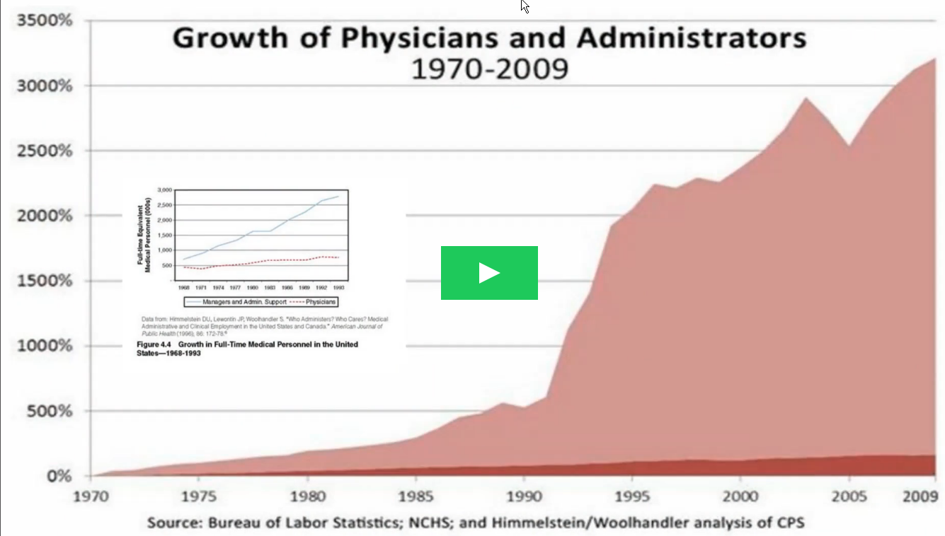

Slide 28
Real-Time Patient–Provider Video Telemedicine Integrated with Clinical Care
ACO-Virtual Care
CVS Virtual Visits
Virtual DR Visits Insurance
virtual Visits enticing employers

Slide 29
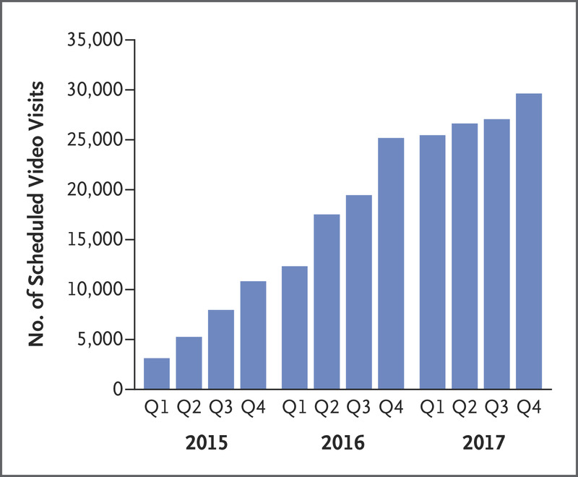
Virtual Care
integrated delivery system that implemented video-visit capability for all clinicians in 2014
examined the characteristics of all 210,383 scheduled video visits among 152,809 patients from 2015 through 2017
Video visits, accessible through Internet-connected, video-enabled mobile devices or computers, could be scheduled by clinicians or patients
Medical history, orders, and visit note associated with each video visit are integrated within the electronic health record (EHR)

Slide 30
Virtual Care
2796 primary care providers conducted a video visit (median, 17 visits per primary care provider).
90% of patients with a video visit had accessed in-person health care in the previous year
Among 81,549 adult primary care video visits, 70% were with the patient’s own primary care provider.

Slide 31
Virtual Care
Patients used smartphones for 74% of video visits
desktop computers for 20%
tablets for 6%
median length of the visits was 8.2 minutes (interquartile range, 5.1 to 13.3)
Fewer than 1 percent of enrollees in large employer health insurance plans used telemedicine services in 2016, according to a separate Kaiser analysis of medical claims data.
encourage md to virtual care

Slide 32
AHP On June 19, 2018, the Department of Labor issued final rule expanding the availability of association health plans (“AHPs”).
AHP – Small Employers can get into the large group insurance market
Large Group Policies not required to have essential health benefits
AHPs are under regulation of State Laws governing MEWAs
Subject to Federal Mandates
  Mental health benefits
  No lifetime or annual limits on certain benefits
  Non discrimination provisions
Language suggests that national associations based on such characteristics could establish subgroups along relevant industry or business lines or that associations form within states or metropolitan areas.
one substantial business purpose unrelated to providing health coverage. According to the final rule, a substantial business purpose exists if the association would be a viable entity in the absence of sponsoring an employee benefit plan.

Slide 33
SUMMAry of New AHP Rule
This rule, which was promulgated by the U.S. Department of Labor (“DOL”), is titled “Definition of ‘Employer’ Under Section 3(5) of ERISA—Association Health Plans” (“final rule”). The final rule has an effective date of August 20, 2018.

Slide 34
Summary of Final Rule
Expands the definition of an “employer” within the portion of the Employee Retirement Income Security Act of 1974 (“ERISA”) defining who can be the sponsors of a multiple employer group health plan (also known as a “multiple employer welfare arrangement” or “MEWA”)
expanded definition loosens the “commonality of interest” standard to enable more and larger groups to form associations and collectively purchase group health insurance
employer groups or associations would meet the commonality of interest criteria if their members were in the same trade, industry, line of business, or profession, or maintained their principal places of business in a region that does not exceed the boundaries of the same State, or in the same metropolitan area (even if the metropolitan area includes more than one State
DOL’s final rule added the requirement that these employers or groups also have at least one common substantial business purpose (unrelated to offering health coverage)

Slide 35
Summary of Final Rule
employer control over the association, which was modified slightly in the final rule in that the final rule clarifies that the control need not be over the day-to-day affairs of the group, but instead states that control will be determined pursuant to a multi-factor “control test.”
“does not modify or otherwise limit existing State authority as established under . . . ERISA.” The final rule acknowledges that “in the case of fullyinsured AHPs, it is the view of the Department [of Labor] that ERISA . . . clearly enables States to subject AHPs to licensing, registration, certification, financial reporting, examination, audit, and any other requirement of State insurance law necessary to ensure compliance with the State insurance reserves, contributions and funding

Slide 36
New Rules
AHPs may not condition eligibility for benefits or rate premiums based on health factors.
Employment-based classifications such as part-time or full-time employment status do not violate the HIPAA nondiscrimination requirements and may be used in determining eligibility or setting rates.
final rule also confirms that working owners and sole proprietors may be treated as employers for membership in an AHP and as employees eligible for coverage under the plan
DOL included a specific provision that participation in an AHP will not subject employers to joint employer liability under any other federal or state law, rule or regulation
businesses will not be considered an employer of its independent contractors merely by its participation in an AHP with those independent contractors that participate in the same AHP as working owners.
The final rule affirms this joint structure and does not reduce the “historically broad role of the states” regulating MEWAs, including AHPs.

Slide 37
MEWA Rules (State and Federal) Still Apply
States regulate MEWAs by, among other things, requiring that a MEWA operating in a State be licensed, registered, and have a minimum number of participating employers; obtain an actuarial opinion confirming that it can meet promised benefits; and maintain a minimum level of reserves
provide a potential future mechanism for preempting State insurance laws that the DOL deems go too far in regulating self-funded AHPs in ways that interfere with the goals of the final rule
New York State and Massachusetts recently announced intentions to sue the Trump administration over this final rule, arguing that the final rule invites abuse and fraud

Slide 38
ERISA Obligations Will Apply
subject to the disclosure requirements of ERISA
summary plan description (“SPD”) and summary of material modifications to participants.
  description of the cost-sharing provisions,
  limits on benefits
  extent to which preventive services, prescription drugs medical tests, and procedures are covered under the plan
  Uniform Glossary must also be provided, and the AHP must disclose the services it does not cover.

Slide 39
Fewer ACA Requirements Apply
AHPs may not be subject to the requirement to provide essential health benefits (“EHBs”
DOL declined to adopt recommendations to make the provision of EHBs a condition for a group or association to qualify as a bona fide association.
the participating applicable large employers still face the possibility of having to make an employer shared responsibility payment if the AHP does not provide minimum value coverage.
AHPs must provide coverage for certain recommended preventive services without imposing cost sharing.
Civil Rights Act of 1964 generally provides that pregnancy-related expenses for employees and spouses must be reimbursed in the same manner as those incurred for other medical conditions.
participating employers, depending on size, may still be subject to other rules, such as the Mental Health Parity and Addiction Equity Act.

Slide 40
HIPAA Nondiscrimination Rules Apply
AHPs may make distinctions based on bona fide employment-based classifications consistent with an employer’s usual business practice, the DOL confirmed that an association that seeks treatment as a single employer under ERISA may not treat different employers as different groups based on a health factor of an individual or individuals within an employer member.
final rule clarifies that AHPs can charge employer members varying amounts based on non-health factors, such as age, case size, industry, geography, and gender.
AHPs can vary benefits, the amount of premiums, and premium contributions based on a single member’s participation in a wellness program.

Slide 41
A small HSA fix could produce big results.pdf
https://www.griffinbenefits.com/employeebenefitsblog/alternative-health-plan-options-for-small-employers-mewas-ahps
MEWAs-AHP
Association-Health-Plans
AHP - Epstein-Becker
final AHP Rule
Epstein-Becker-AHP-2

Slide 42
OTC labs – Direct Patient Care

Slide 46
Test | What this test measures | What test results may indicate Low values High values
Platelet count | Platelets are necessary for normal blood clotting, and counts may be affected by several disease states | Chemotherapy Hemolytic anemia Hypersplenism | Post-splenectomy syndrome Primary thrombocytosis Certain malignancies
 |  | Idiopathic thrombocytopenia purpura | Early chronic myelogenous leukemia
 |  | Vitamin B12 or folate deficiency | Polycythemia vera
 |  | Leukemia | Rheumatoid arthritis
 |  | Prosthetic heart valves
 |  | Sequelae of massive blood transfusion
 |  | Disseminated intravascular coagulation

Slide 47
Test | What this test measures | What test results may indicate Low values High values
Glucose, fasting | Direct measure of glucose | Pancreatic disorders | Diabetes mellitus Increased circulating epinephrine (e.g., due to emotion, burns, shock, anesthesia) Acute or chronic pancreatitis Vitamin B1 deficiency Drug interactions
 | Common evaluation of diabetes and hypoglycemia | Endocrine disorders (e.g., early diabetes mellitus)
 |  | Malnutrition
 |  | Liver damage (alcoholism)
 |  | Insulin overdose
 |  | Hypoglycemia
Uric acid | Evaluation of gout, recurrent urinary stones, or kidney failure | Overhydration Severe liver damage | Gout Impaired kidney function
 |  | Malnutrition | Leukemia
 |  | Low protein intake | Dehydration
 |  |  | Shock
 |  |  | Urinary tract obstruction
 |  |  | High protein intake

Slide 49
Home Labs
https://www.amazon.com/Second-Generation-Immunochemical-Colorectal-Cancer/dp/B00ICK0ZPK

Slide 50
How healthcare providers can use wearables to reimagine the delivery of care…
After a shaky start, wearables — including smartwatches, fitness trackers, and other connected devices — have gained traction in the healthcare industry driven by consumers' demand to play a more active role in managing their health.
US consumer use of wearables for health purposes jumped from 9% in 2014 to 33% in 2018. And penetration should continue to climb — more than 80% of consumers are willing to wear tech that measures health data.
The growing adoption of wearables and the breadth of health functions they offer will paint a fuller picture of consumer health and behavior, enabling healthcare organizations to differentiate from the competition, drive value, and engage consumers.

Slide 51
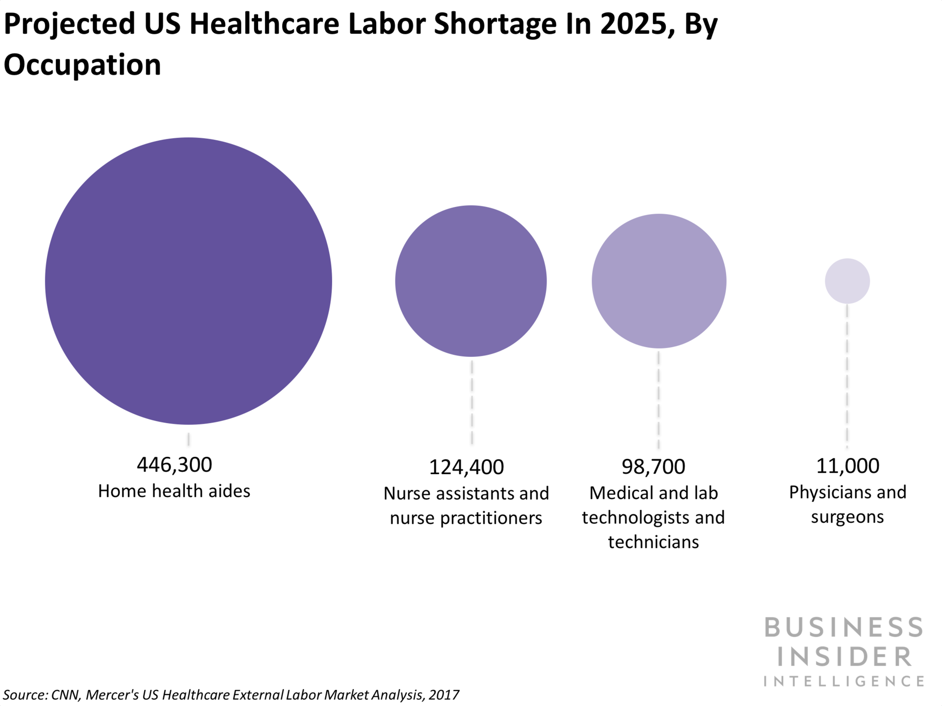
Wearables

Slide 52
Here are some other key points from this coverage:
Wearable devices can help providers navigate the shift toward VBC and better manage chronic disease. 91% of healthcare providers surveyed say wearables are a key component of their IoT health solutions.
Wearables could help providers redistribute the burden of care by empowering patients to manage a large portion of their own diseases. For example, diabetes patients who used a wearable insulin delivery device improved their blood sugar levels and reduced their pharmaceutical costs.
Automating the collection of health data could maximize staff productivity. If a patient shared biometric information captured in wearables prior to their annual office visit, primary care physicians (PCP) could save an average of five minutes per encounter.

Slide 53
An Association Health Plan (AHP) is a specific type of ERISA-covered group health plan that is sponsored by a group or association of employers, instead of a single employer, to provide health coverage to the employees of the AHP’s employer members. Under ERISA, an AHP is both a group health plan and a multiple employer welfare arrangement (MEWA).
The Department’s new rule, published on June 21, 2018, allows more employer groups and associations to form AHPs, and allows AHPs to offer coverage to some or all employers in a state, city, county, or a multi-state metro area, or to businesses in a common trade, industry, line of business, or profession in any area, including nationwide. In addition, working owners without other employees (including sole proprietors) can join AHPs to receive health coverage for themselves and their families

Slide 54
What ERISA provisions apply to AHPs?
subject to reporting and disclosure requirements, claims procedure rules, and fiduciary rules
must comply with health care continuation coverage provisions under the Consolidated Omnibus Budget Reconciliation Act of 1985 (COBRA), and the health care protections provided in the Health Insurance Portability and Accountability Act (HIPAA), the Affordable Care Act, the Mental Health Parity and Addiction Equity Act, and other group health plan laws

Slide 55
AHP
ahp forms
Final AHP Rule
TPA Forms

Slide 56
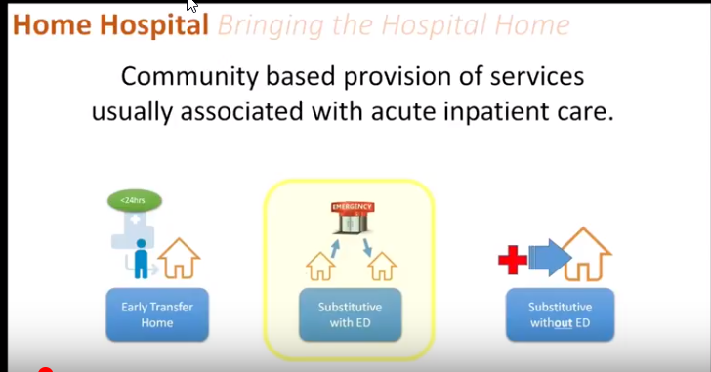

Slide 57
WHY HOSPITAL SOME WHERE ELSE
UNINTENDED CLINICAL CONSEQUENCES
1/3 NEVER REGAIN FULL FUNCTIONAL STATUS
20% SUFFER DELERIUM
EXPENSIVE
10% HOSPITAL ACQUIRED CONDITIONS

Slide 58
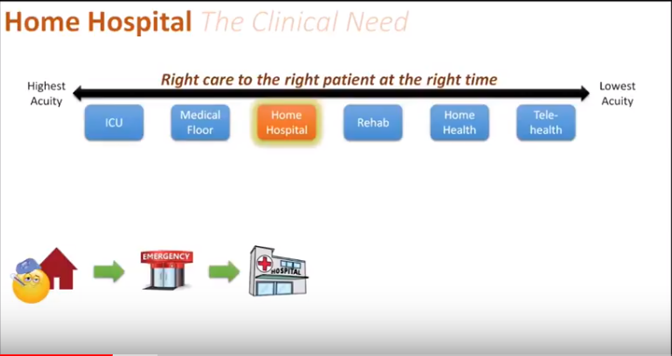

Slide 59
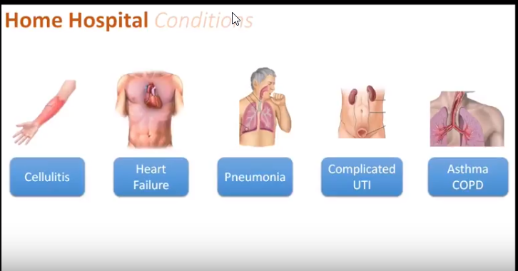

Slide 60
HOSPITAL SOME WHERE ELSE
HOSPITAL ASSOCIATED INFECTIONS
INFECTION
SKIN AND SKIN STRUCTURE INFECTIONS
CENTRAL LINE BLOOD STREAM
ADMISSION SKIN AND SOFT TISSUE INFECTIONS
ACCOUNTS FOR AT LEAST 2% OF HOSPITAL ADMISSIONS WITH HOSPITAL STAY MEAN 5 DAYS
¼ of patients presenting to ED are admitted
15% treatment failure
4 million patients are seen in the ED for SSTI
Increase by 1 million since 2007
Guideline Mild Moderate Severe
CATHETER UTI
SURGICAL SITE
CELLULITIS
OSTEOMYELITIS
VENTILATOR ASSOCIATED PNEUMONIA
URINARY TRACT

Slide 61

HOSPITAL SOME WHERE ELSE
RESPIRATORY
COPD EXACERBATION
PNEUMONIA
ASTHMA

Slide 62
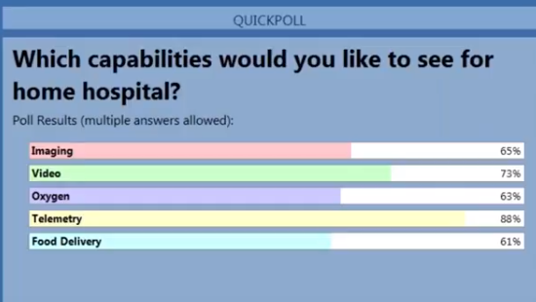

Slide 63


Slide 64


Slide 65


Slide 66
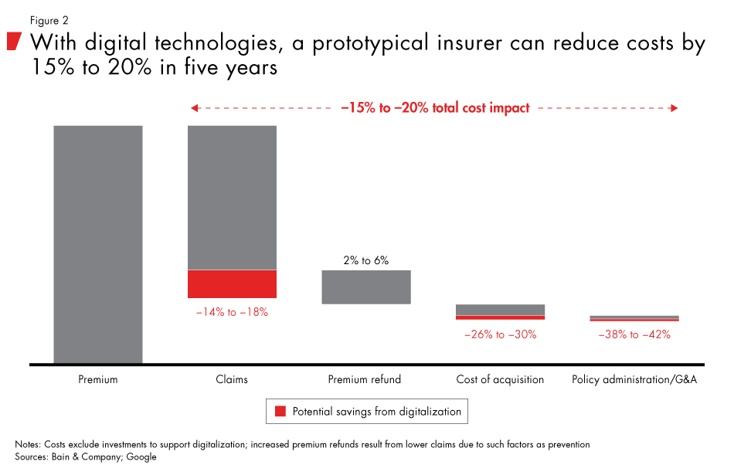

Slide 67
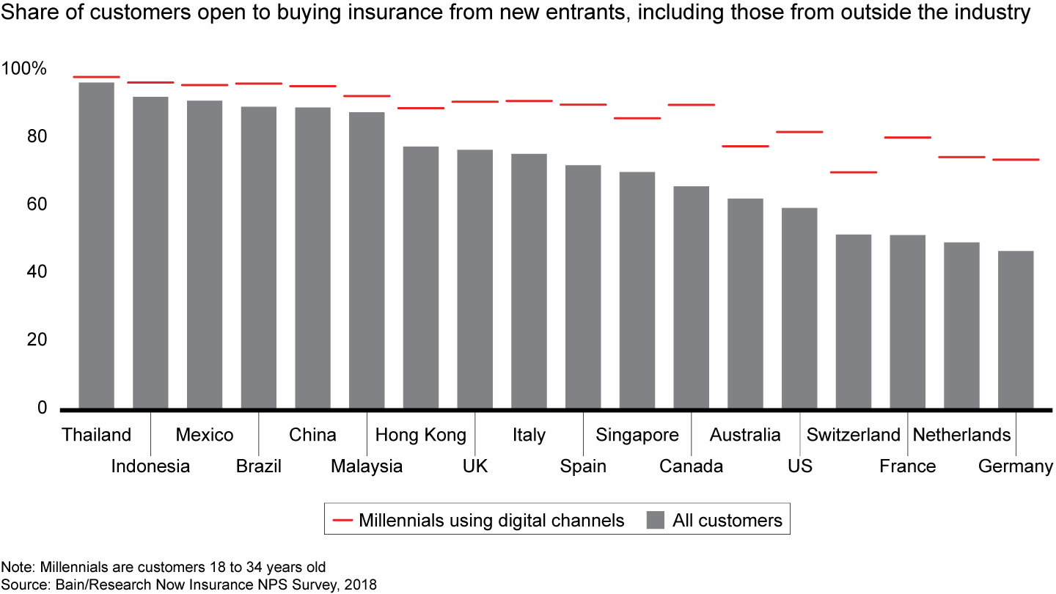

Slide 68
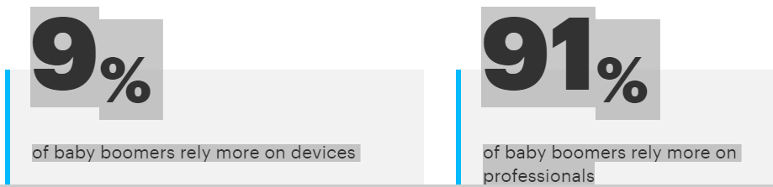
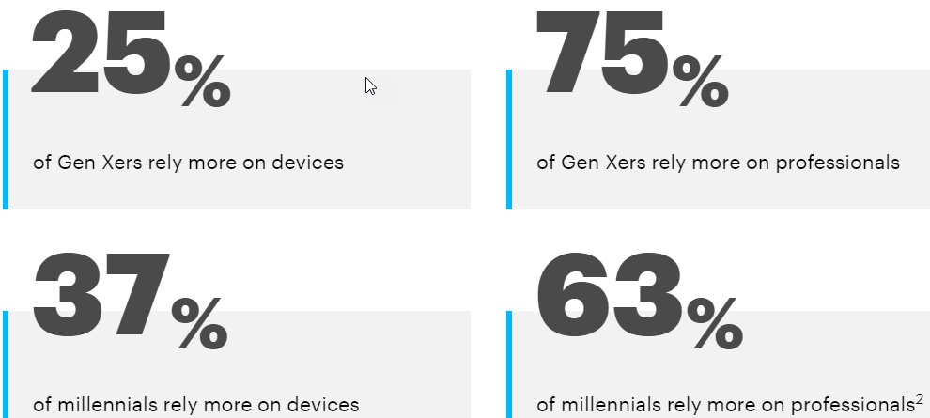
Who relies on digital devices to manage health?

Slide 69
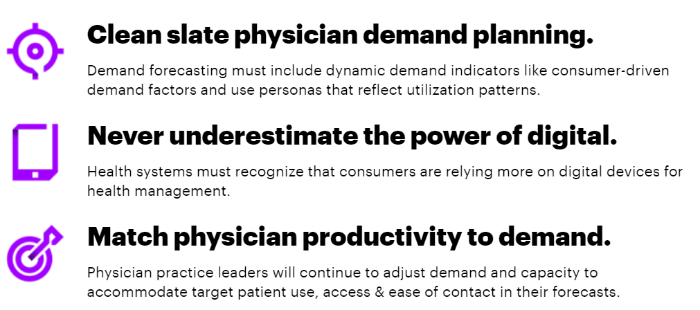

Slide 70
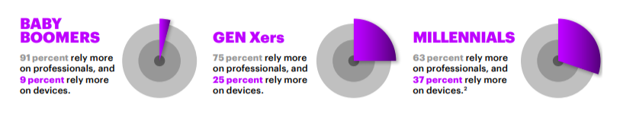

Slide 71
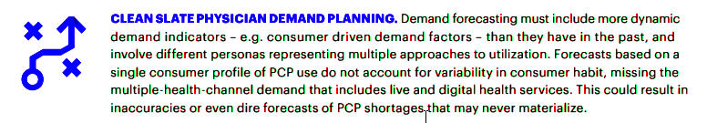
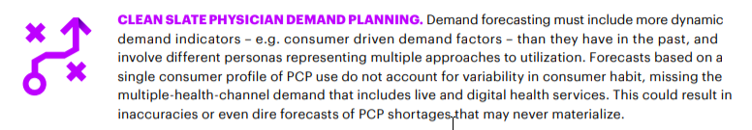

Slide 72


Slide 73

The convergence of digital health and new consumer demand for providers is driving integrated access, experience and capacity. And it must also integrate the patients’ definition and demand for personal and digital contact with a broad set of providers, not just the traditional primary care provider.

Slide 74
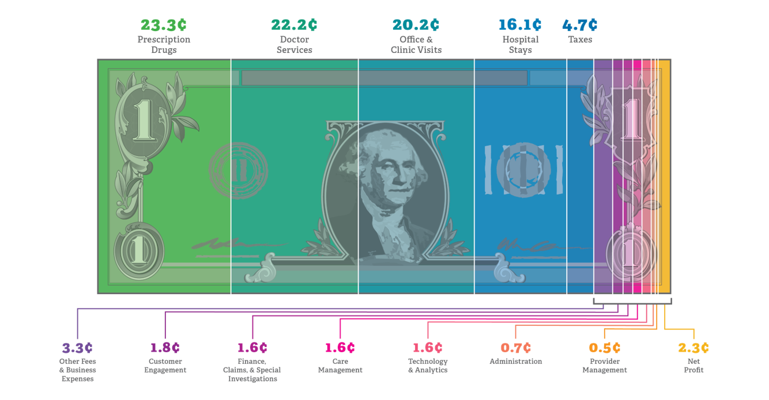

Slide 75


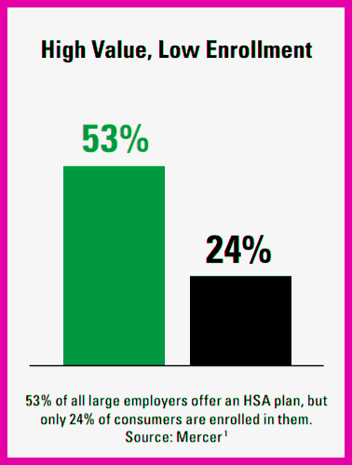
A Three-Step Approach to Success HSA

Slide 76






DPC
MEDS
MEDICARE
LTC

Slide 77

HIGH DEDUCTABLE HEALTH PLAN
HSA – TAX ADVANTAGE
Contribution pays premiums – Medical Expenses (DPC)
Your Personal Deposits

